Slide 1

GANADIPATHY TULSI’S JAIN ENGINEERING COLLEGE
SEGMENTATION OF KIDNEY STONES IN
ABDOMINAL X-RAY IMAGES
Batch no: 06
Team Members:
C.GAYATHRI - 510820104006
C.SARANYA - 510820104016
A.SHANMATHI - 510820104017
Project Guide & Co-ordinator:
Mrs.S.I.Santhanalakshmi.M.E.,
CSE-HOD,
GTEC.

Slide 2
Objective
Our aim is to detect the stones and measure the size of the stone in x-ray images by using LR algorithm.

Slide 3
Abstract
Urinary stones can be detected using CT-scanning and x-ray imaging.
Logistic regression algorithm is used for urinary stone detection in medical images.
The Image processing method is used in order to get an enhanced image or to extract some useful information from it.
In addition ,inverse weighting method are also used.

Slide 4
Introduction:
A urinary stone, or renal calculi, is one of the most frequent abnormalities in the urinary system.
Urinary stones can be detected by various medical imaging modalities.
An abdominal x-ray or KUB radiography can detect urinary stones because most stones are calcified.

Slide 5
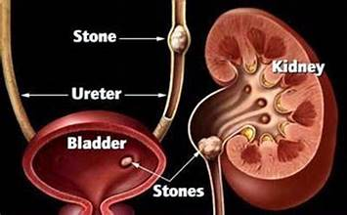
Kub Region:

Slide 6
Literature Survey :
TITLE | AUTHOR | PROPOSED SYSTEM | LIMITATIONS
TransUNet: Transformers make strong encoders for medical image segmentation (2021) | J. Chen, Y. Lu, Q. Yu, X. Luo | Transformer architecture has demonstrated remarkable success across various NLP tasks & perform segmentation which generate maps. Technique: CNN | Longer training times. Higher computational resource.
SinGAN-Seg: Synthetic training data generation for medical image segmentation (2022) | P.Salehi, S.A.Sheshkal, H.L.Hammer, | Deep learning-based segmentation methods have shown remarkable performance but often require large amounts of data for training and create frameworks. Technique: SinGAN | Lack of robustness. limit the applicability.
TITLE

Slide 7
TITLE | AUTHOR | PROPOSED SYSTEM | LIMITATIONS
Adversarial inpainting of medical image modalities (2019) | Y. Mecky, B. Yang, | GAN network-reconstructing images i.e damaged region within medical images. Proposed approach in various medical imaging modularity include MRI, CT etc.. Technique: GAN | Longer training times. Higher computational resource.
MultiResUNet: Rethinking the U-Net architecture for multimodal biomedical image segmentation. (2020) | M. S. Rahman | The MultiResUNet architecture proposes enhancements to the U-Net framework for multimodal biomedical image segmentation. Technique: multipleUnet | Additional convolutional operations.

Slide 8
TITLE | AUTHOR | PROPOSED SYSTEM | LIMITATIONS
Using synthetic training data for deep learning-based GBM segmentation (2019) | L. Lindner & M. Weber | Synthetic data(artificial) generation has emerged as a potential solution to address this issue. Technique: GBM | Inaccurate or unrealistic synthetic data. Degrade the performance.

Slide 9
Existing System:
In the existing system, Visual Inspection are used.
It is a form of non-destructive testing (NDT).
The minutes contaminates & flaws cannot be measure by human sight.
The radiography and ultrasonography technique are also used to detect the anatomical structures in 2D image.

Slide 10
Drawbacks:
Time consuming.
Human error.
Limited sensitivity and automation.
Limited specificity.
Can’t predict stone size.

Slide 11
Proposed System:
In the proposed system, logistic regression algorithm is used.
We propose the LR model for urinary stone which include Data Selection and Preprocessing, Feature Extraction, Model Development & Segmentation.
Lesion-size reweighting approach.

Slide 12
Advantage:
Unwanted parts – removed.
Easy to detect the stones either in small or large size
Flexibility
Reduced dimensionality.
Reduced human error.

Slide 13


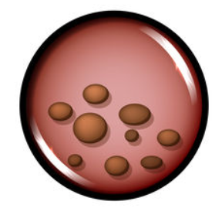
Architecture Diagram:
Select and View Dataset
Stone data
Classification
Dataset
Healthy kub region image
Prediction
Pre-processing
Result Generation
No Stone
Stone found
Size:3.3mm
Feature Selection

Slide 14
Flow Diagram:
Abdominal X-ray Image Dataset
Image Resize
PREPROCESSING
Gray Scale Conversion
Gradient
FEATURE EXTRACTION
Test Image
Proposed System
IMAGE SPLITTING
Train Image
LR
Existing System
CLASSIFICATION
Accuracy
RF
Precision
Recall
If Stone,
Show Size
Healthy or Stone
PERFORMANCE ANALYSIS
F1-Score

Slide 15
Modules:
MODULE 1: Image Collection
MODULE 2: Preparation
MODULE 3: Feature Extraction
MODULE 4: Image Splitting
MODULE 5: LR Model Development
MODULE 6: Performance Estimation

Slide 16
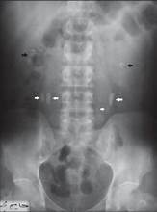
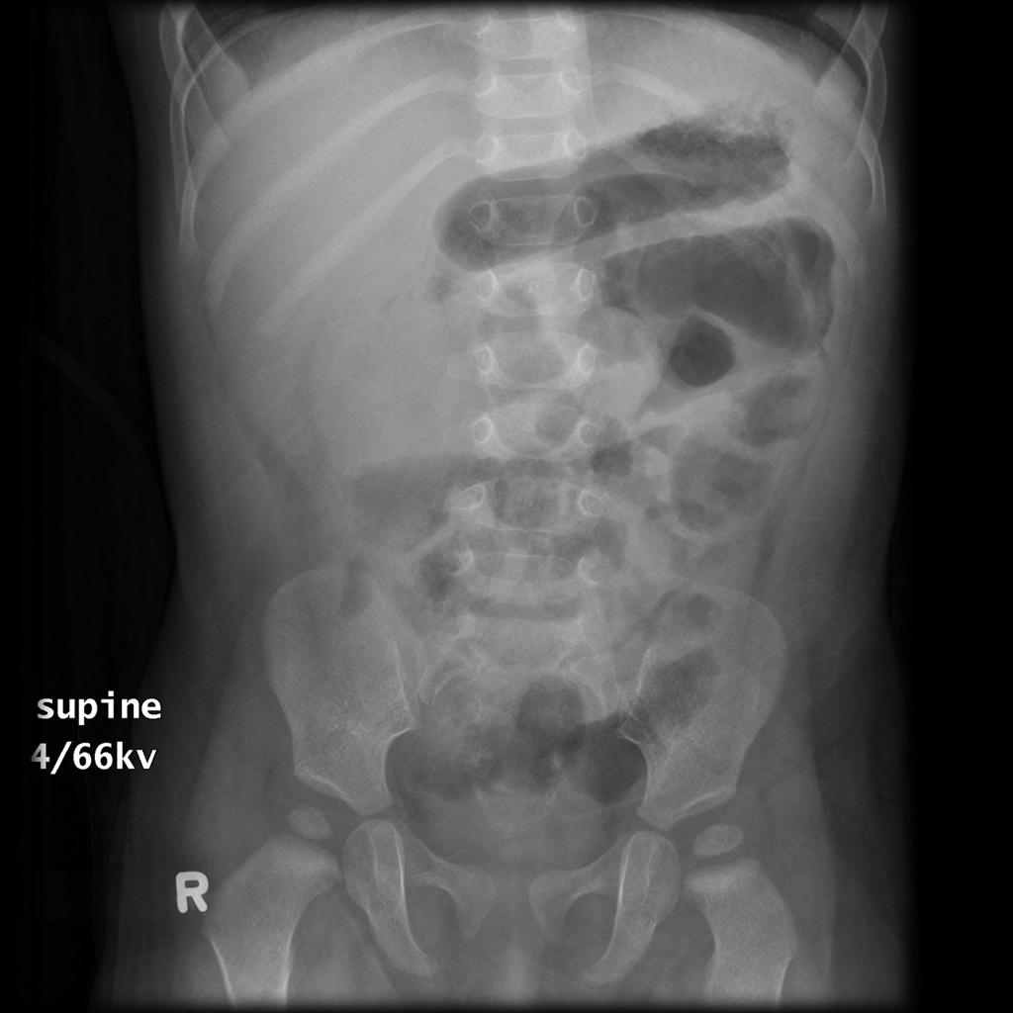

Image Collection:
Collecting a image which contain a stoned image and non stoned image and stored in the dataset.
Models to spot kidney stones accurately.
+
DATABASE
STONE CONTAIN IMAGE
STONE FREE IMAGE

Slide 17
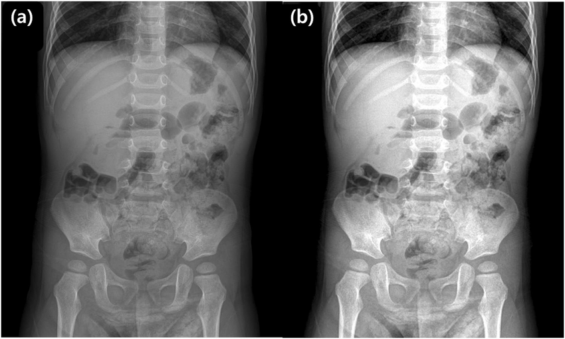
Preparation:
Resize all the collected images to a standard size.
Perform general preprocessing tasks.
Preprocessing
An Abdominal X-Ray image before preprocessing.
Adjust brightness & contrast and Improve the quality.

Slide 18
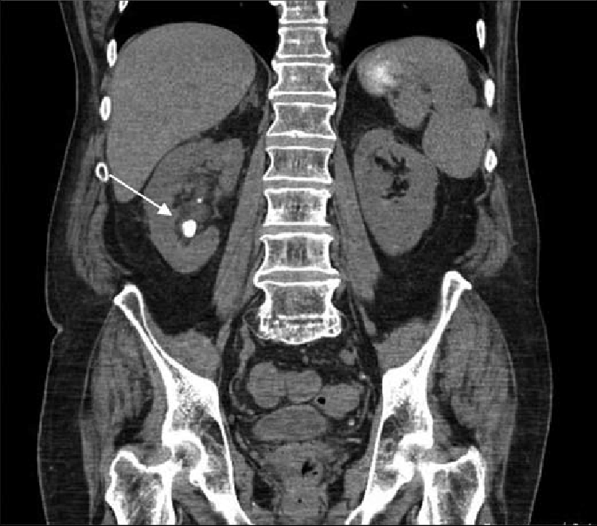
Feature Extraction:
Finding important details in the images that help tell urinary stones apart from the surrounding tissues & looking for patterns for accurately.
Extract
Pre-Processed Image
Look for patterns like color, texture etc..

Slide 19
Image Splitting:
Split the dataset into two subsets: the training set and the testing set.
Training set - teach the model patterns
Testing set - evaluate the model
TRAINING SET
SAMPLE
DATASET
75%
QUERY
25%
TESTING SET
SUPPORT
TEST

Slide 20
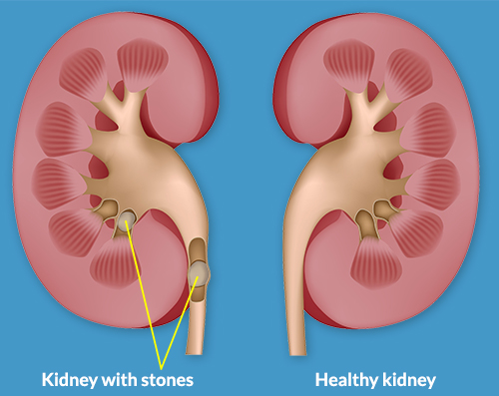
LR Model Development:
It figures out how to tell if a picture contains a urinary stone or not.
This process helps us build a system that can automatically identify urinary stones.
Y1
LR MODEL
X1
STONE
X2
Y2
X3
Y3
NO STONE
INPUTS: X1,X2,X3; IMAGES:Y1,Y2,Y3;

Slide 21
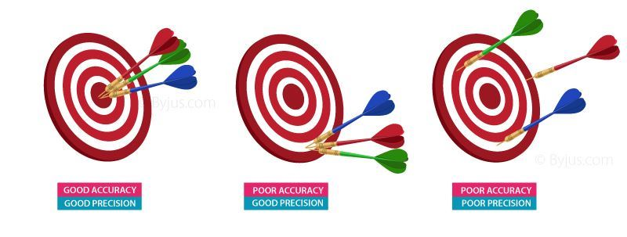
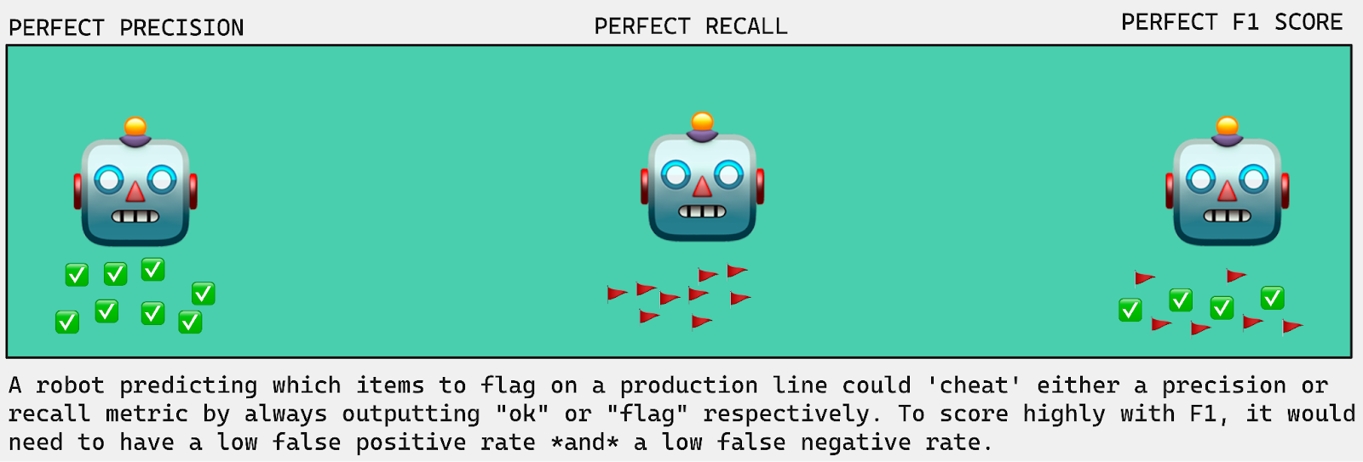
Performance Estimation:
To check how well it performs using the testing dataset. And also use a performance metrics like accuracy, precision, recall, and F1 score to evaluate its effectiveness.
ACCURACY- Predicts Overall Correctness
PRECISION- Predicts how often it’s right
RECALL- How many stone it finds compared to all the stones.
F1 SCORE- Balanced measure of performance.

Slide 22
Stone Formation:
Solid deposits of mineral and salt ----> holding of urine.
Stages :
Starting point
Getting together
Growing up
Making friends
Hanging out
Going through/blocking.

Slide 23
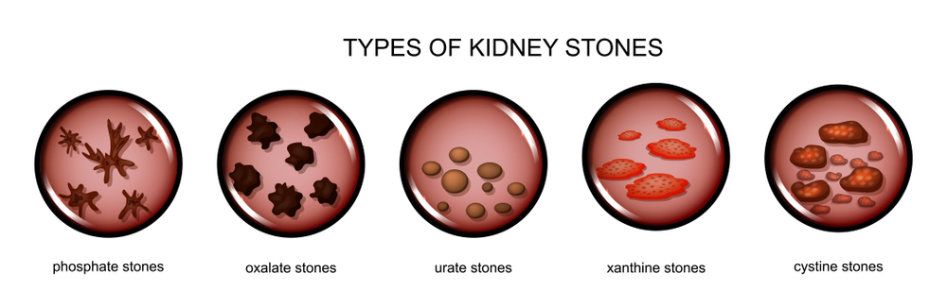
Types of kidney stones:

Slide 24
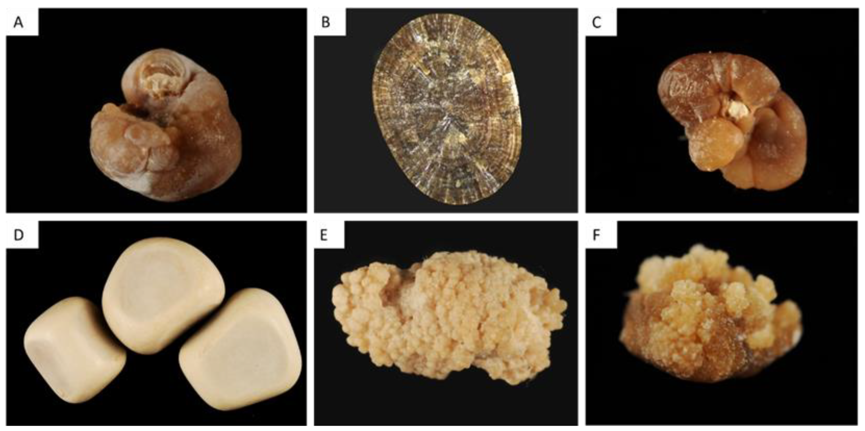
Sizes of Kidney Stone:
Average size → 3-4 mm
Big size → 5 mm ➔ ‘Large’ or ‘Big’.
Small size → <1 mm ➔ ‘Grains’ or ‘Sand’.
Shapes of kidney stone:
Smooth & Round
Irregular
Stellate
Branching
Faceted
prismatic

Slide 25

Symptoms:
Severe pain.
Blood in urine.
Painful urination.
Burning sensation.
Irritation.
Frequent urination feeling.
Foul-smell.
Difficulty in passing urine.
Others ----> fever,chills.

Slide 26
Algorithm:
Logistic Regression (LR) is a statistical method used for binary classification problems, where the outcome variable is categorical and has only two possible classes.
The logistic regression algorithm models the probability that an instance belongs to a particular class.
Features:
Interpretability.
Efficiency.
Scalability.
Probabilistic.
Robustness.

Slide 27
Methodologies:
Lesion Reweighting:
Accurately identify and analyze urinary stones in medical imaging.
Segmentation:
Dividing a picture into smaller, meaningful parts.

Slide 28
System Configuration:
HARDWARE REQUIREMENTS:
• PROCESSOR : INTEL DUAL CORE,I5
• RAM : 3 GB
• HARD DISK : 200 GB
• MONITOR : 18’ LED COLOR
SOFTWARE REQUIREMENTS:
• LANGUAGE : JAVA
• OPERATING SYSTEM : WINDOWS 10
• USER INTERFACE DESIGN : JFRAME
• DATABASE : MYSQL
• SERVER : XAMPPSERVER

Slide 29
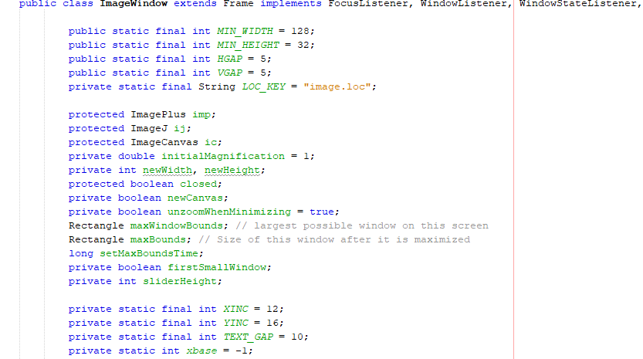
Sample Code:

Slide 30
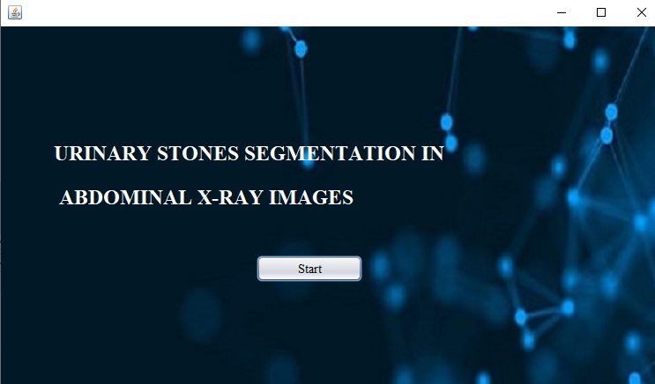
Home Page:

Slide 31
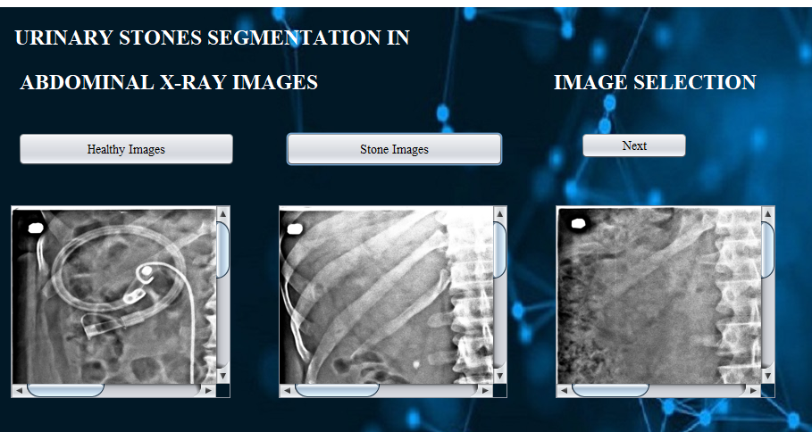
Image Selection:

Slide 32
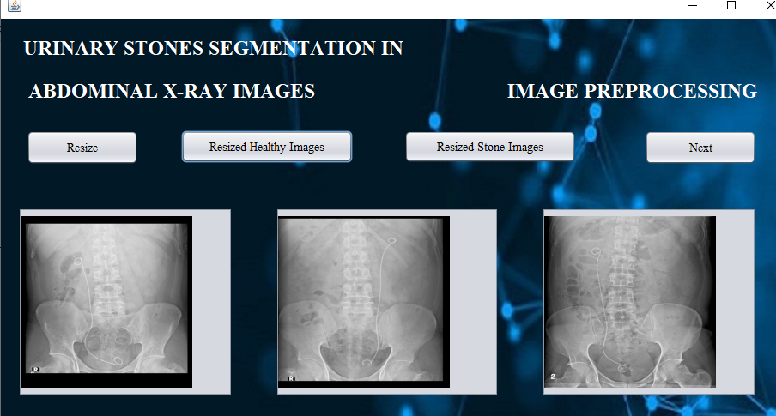
Preprocessing:

Slide 33
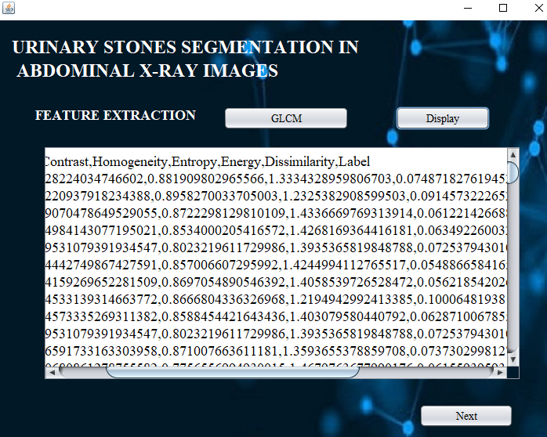
Feature Extraction:

Slide 34
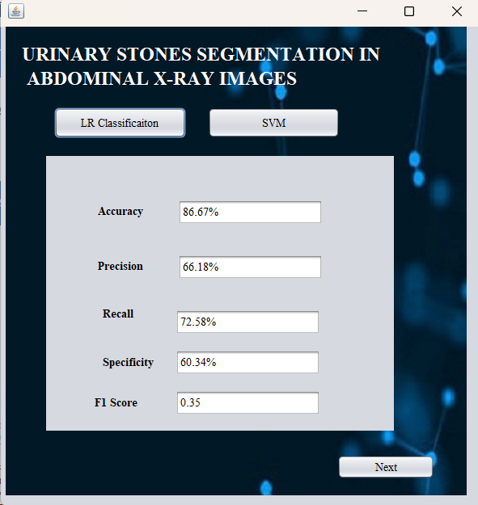
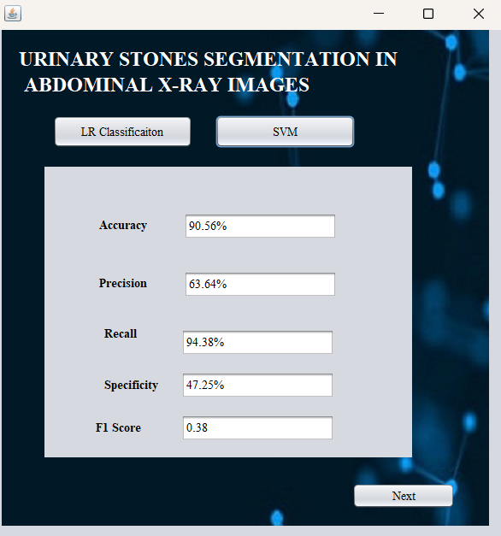
Classification:

Slide 35
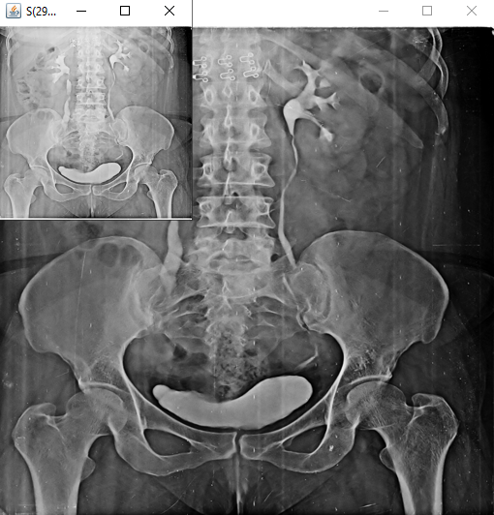
Input Image:

Slide 36
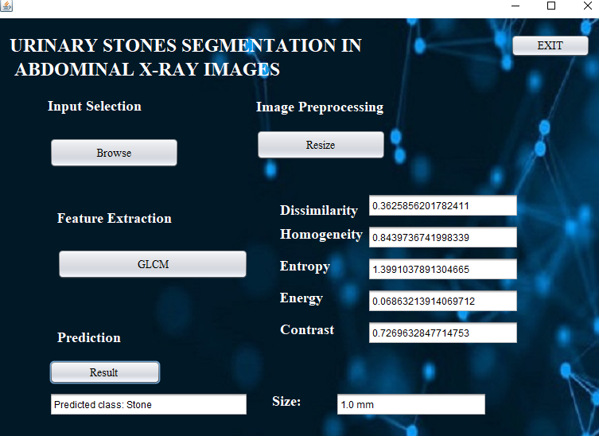
Prediction:

Slide 37
Conclusion:
In conclusion, this will investigate the application of logistic regression for urinary stone segmentation in abdominal X-ray images.
Through the development and evaluation of a logistic regression-based model, we have demonstrated promising results in accurately identifying urinary stones within the images.
Thus the proposed methodology enhances the detection of urinary stones using an advanced approach.

Slide 38
Future Work:
Develop real-time urinary stone segmentation systems for clinical use, considering speed, efficiency, and usability in medical settings.
Extend the segmentation framework to automatically quantify urinary stone characteristics such as size, shape, and location, facilitating more comprehensive diagnostic and treatment planning processes.

Slide 39
References:
[1] P. R. Tamilselvi and P. Thangaraj, “Computer aided diagnosis system for stone detection and early detection of kidney stones,” J. Comput. Sci., vol. 7(2), 2021, pp. 250-254. https://doi.org/10.3844/jcssp.2011.250.254.
[2] P. Sun et al., "Kidney Tumor Segmentation Based on FR2PAttU-Net Model," Front. Oncol. 2022. doi: 10.3389/fonc.2022.853281.
[3] W. Preedanan et al., "Improvement of Urinary Stone Segmentation Using GAN-Based Urinary Stones Inpainting Augmentation," in IEEE Access, vol. 10, pp. 115131-115142, 2022, doi: 10.1109/ACCESS.2022.3218444.
[4] P. T. Akkasaligar, S. Biradar and V. Kumbar, "Kidney stone detection in computed tomography images," 2017 Int. Conf. Smart Technol. Smart for Nation (SmartTechCon), Bangalore, 2017, pp. 353-356.
[5] W. Brisbane, M. R. Bailey, and M. D. Sorensen, “An overview of kidney stone imaging techniques,” Nat. Rev. Urol., vol. 13(11), pp.654-662, doi: 10.1038/nrurol.2016.154

Slide 40
THANK YOU

